Slide 1
Next generation sequencing workshop 2
Dr. Cheng Zhang
Senior Lecturer
King’s College London

Slide 2
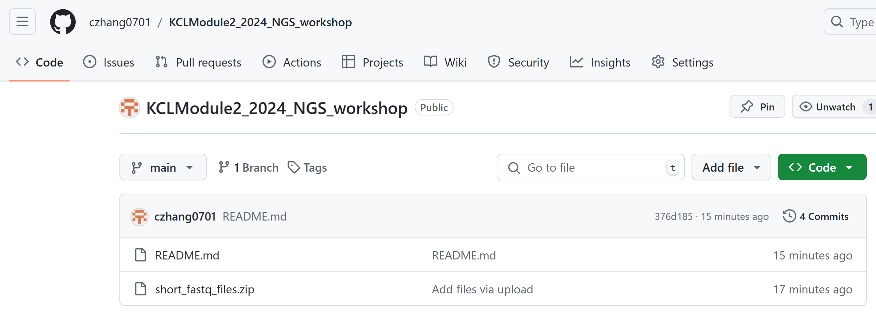
The Github
czhang0701/KCLModule2_2024_NGS_workshop (github.com)

Slide 3
Section 4: Sort the BAM file
Log into Galaxy.
Search for Samtools Sort in Galaxy.
Input the BAM file generated from the alignment step and run the sorting tool.

Slide 4
Section 5: Variant Calling Using MiModD
Search for MiModD Variant Calling in Galaxy.
Input your sorted BAM file and the reference genome (ensure it matches the one used for alignment).
Run the tool to identify SNPs and INDELs, and generate a BCF file with the detected variants
Use BCFtools View in Galaxy to convert the BCF file into a VCF file for further analysis.

Slide 5
Section 6: Variant Calling Using MiModD
Go to Variant Effect Predictor (VEP) on www.ensembl.org.
Register an account.
Upload the VCF file generated by MiModD.
Select the appropriate reference genome (e.g., GRCh38).
Run the annotation process (Any issue here?).
Download the Annotated VCF file.

Slide 6
Section 7: Explore Variants Using IGV Web
Go to the IGV Web App.
Upload both the sorted BAM file and the annotated VCF file from the previous steps.
Try to find SNP/SNV and INDELs.

